Slide 1
What is machine learning

Slide 2
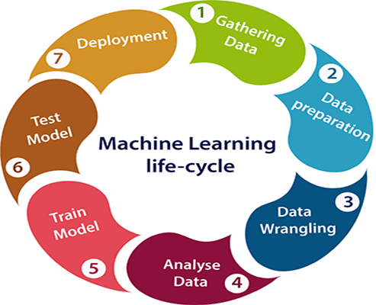

Slide 3
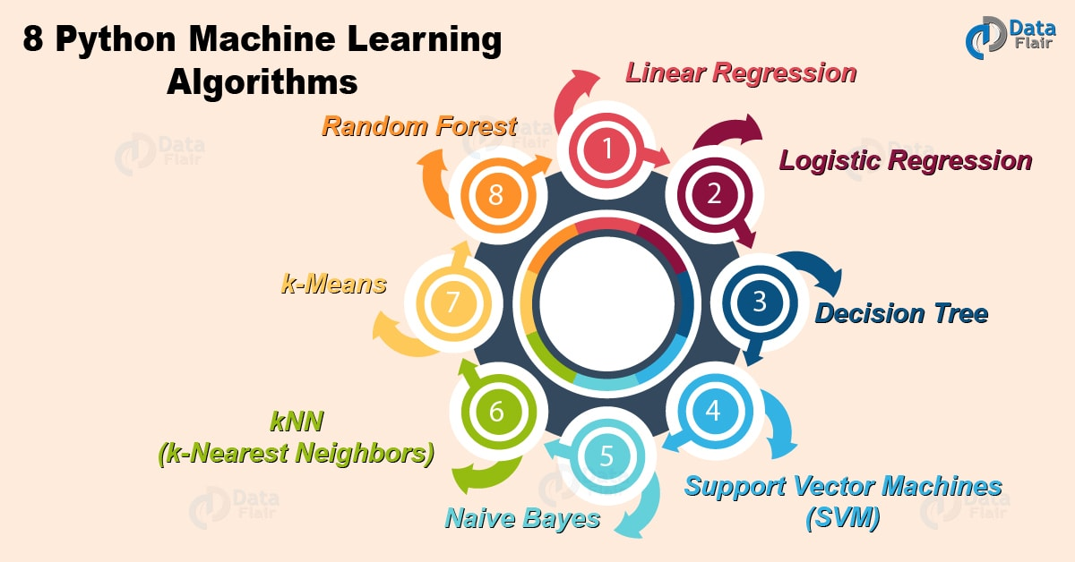

Slide 4
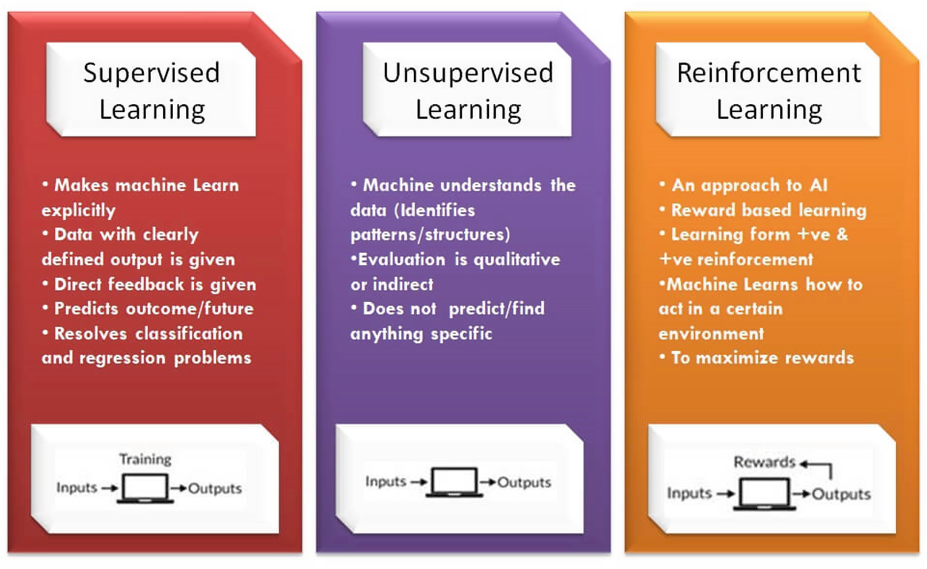

Slide 5
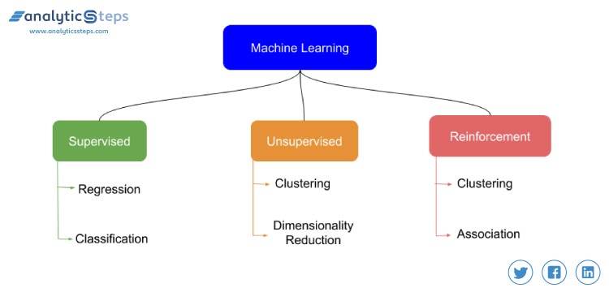

Slide 6
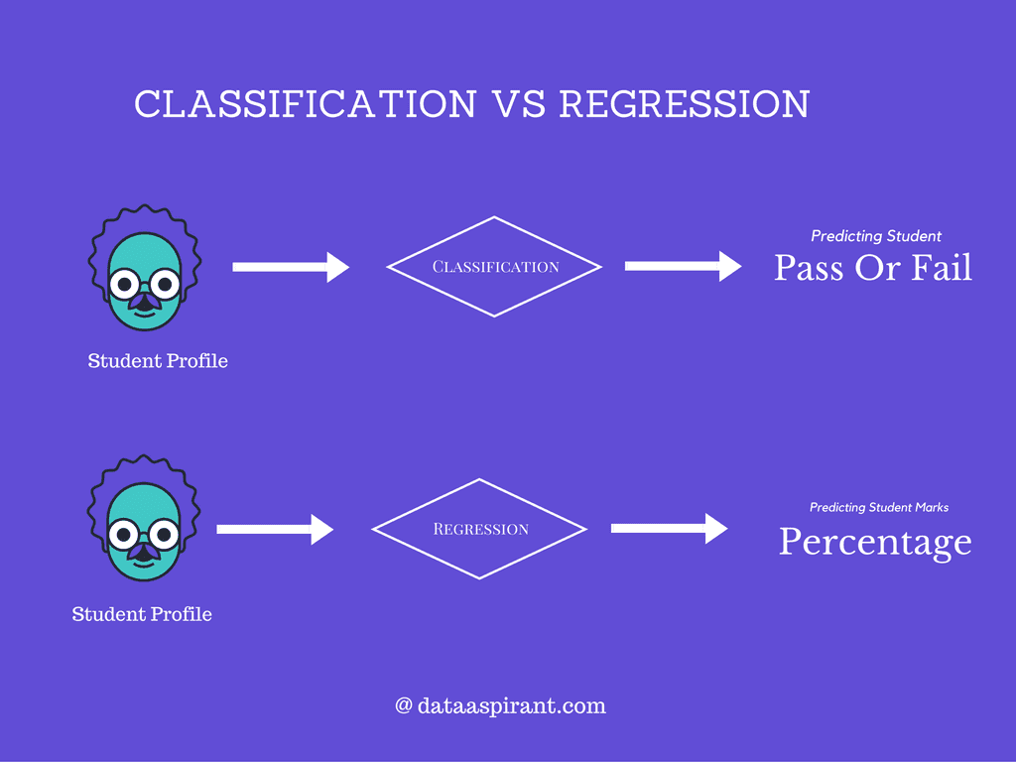
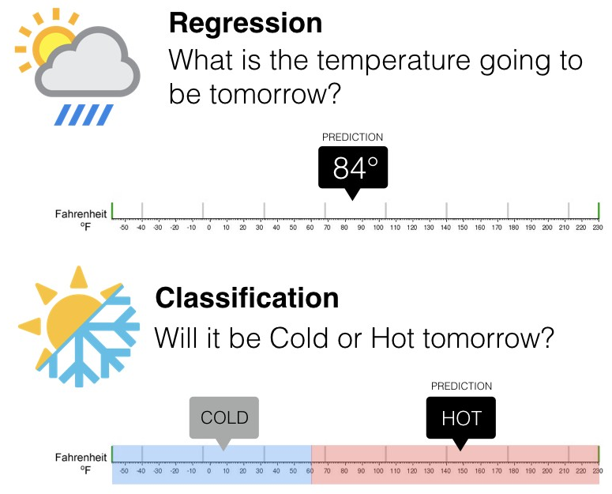
Classification:
Logistic Regression
Support Vector Machine
Decision Tree
Naïve Bayes
Random Forest
Regression:
Linear Regression
Random forest

Slide 7
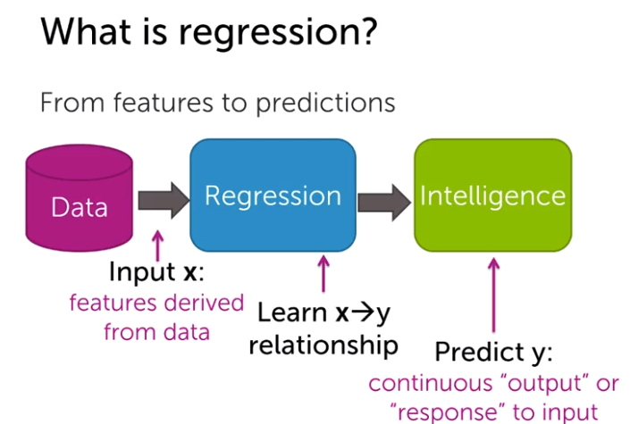

Slide 8
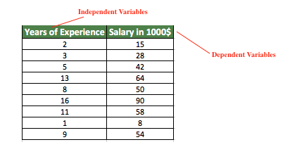

Slide 9
